Slide 1

Network of Senior Advisors & Consultants
Strategy:
  Practical Definitions
  Evolution
Leveraging Knowledge:
  Who We Are
  What We Do
Features of the AJSCPL Network
Examples of Our Experience
  Functional Expertise
  Industry Experience
Example of a Customized Framework
Engagement
Corporate Purpose
A-Joshi Strategy Consultants (OPC) Private Limited
(Corporate Identity Number: U74900MH2016OPC273249)
www.expertstrat.com
All Rights Reserved

Slide 2
What is Strategy?
Strategy is the determination of long term goals and objectives of a company and the adoption of courses of action and the allocation of resources necessary for carrying out these goals. – Alfred Chandler
(time, target, choice, analysis, implementation, commitment)
Operational effectiveness means performing similar activities better than rivals perform them. Strategy is the creation of a unique and valuable position, involving a different set of activities. - Michael Porter
If everyone can do it, it’s difficult to create and capture value from it.
Strategy is an integrated overarching concept of how a business will achieve its objectives
A-Joshi Strategy Consultants (OPC) Private Limited
All Rights Reserved

Slide 3
Evolution of Strategy
 | 1950s | 1960s | 1970s | 1980s | 1990s | 2000 - 2015 | 2020 onwards
Context | -Post war boom -Financial Budgets | -Economic Boom -New Industries like Electronics | -Oil price shock -Industry life-cycle | -Japanese challenge -M&A failures -Weakness of conglomerate | -Low profitability -New Competitors | -Rapid Evolution -Newer age businesses | -Convergence of Technology
Assumption | High Growth | International Growth | Efficiency | Stable Industry Structure | Firm as set of competencies | Industry has a Business Model | VUCA World
Theme | Budgetary Planning | Corporate Planning | Corporate Strategy | Competitive Advantage | Leveraging Resources | Innovation | Agility & Resilience ?
Framework | Planning & Budgets | SWOT | Strategic Planning Matrix | Industries, Product-Market | Core Competency | Innovation Process Management | Innovation & Organization Design ?
Proponents |  | Kenneth Andrews | BCG | M. Porter | Prahalad/ Gary Hamel | Chan & Mauborgne | ?
-V. Joshi
A-Joshi Strategy Consultants (OPC) Private Limited
All Rights Reserved

Slide 4
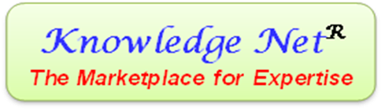

Leveraging Knowledge
Who we are
The core of our company and its activities is Knowledge. We are partners, advisors & consultants providing Expertise which is underpinned by high quality Experience. As Practical Strategists we partner businesses in their growth & requisite transformation by advising relevant & focused solutions which are based on decades of management experience of our Experts.
What we do
We facilitate a premium marketplace for Expertise with leading edge Knowledge givers as Experts, and Knowledge seeking businesses as receivers through the Knowledge Net.® Each of our Experts has more than 20 years of experience with businesses which are leaders in their industries. Our Experts can provide deep insights into various Industries, Businesses & Functions and add significant strategic value to Clients through:
Thought Leadership on Strategy
Corporate & Business Strategy (Formulation & Execution)
Growth, Turnaround & Restructuring
Post M&A Integration Execution
Organization Design (Structure, Systems, Processes, Culture & Style)
Leadership Development
Functional Management (Finance, Marketing, HR, Operations and R&D)
Science & Technology: Insights & Management
A-Joshi Strategy Consultants (OPC) Private Limited
All Rights Reserved

Slide 5
Features of the AJSCPL Network
Each of the Experts has more than 20 years of experience
Several of the Experts have been managers at CXO level
Experience includes implementation of Growth & Turnaround Strategy
Customized implementation frameworks based on extensive experience
Members have several years (decades) of mutual trust
Industries:
FMCG
Textiles
Chemicals
Pharmaceuticals
Automobiles
Industrials
IT / ITES
Telecom
Private Equity &
Venture Capital
Functions:
Commercial
Marketing
Sales
Operations
Leadership
Human Resources
R&D
Project Management
General Management
Health & Safety
Locations:
Bengal
Maharashtra
Bengaluru
NCR
Gujarat
A-Joshi Strategy Consultants (OPC) Private Limited
All Rights Reserved

Slide 6
Examples of Our Experience
Activity | Industries
Corporate & Business Strategy | - Several Companies in Manufacturing - Biotech, Drug Development/Repurposing/ & NCE - Logistics - Fine Chemicals - Personal products
Restructuring & Turnaround | - Low volume customized products manufacturer - CRO - Textiles - Fine Chemicals
Systems and Processes | - Several companies in Manufacturing - Agri-Biotech Company - Facilities Management (services) provider - Fine Chemicals - Personal Products - Environment Management & Remediation
Organization Design | Structure: Functional, Matrix structures Processes: IPM, Budgeting, CapEx, Board Governance Systems: Schedule of Authority, Internal Audit, ERP, Inventory Management, PMS, MIS Culture: Specialized to high volume manufacture, Silos to Cross-functional
Family Conflict & Litigation | One investee companies with successful resolution
Insolvency | - Manufacturing & Services
Due-Diligence Support | - Manufacturing, Services and R&D led companies
A-Joshi Strategy Consultants (OPC) Private Limited
All Rights Reserved

Slide 7
Implementation Framework
Stable?
Forecasted?
Conducive?
Responsive?
Changeable?
Environment
P,R,E,S,T
Industry
Vision
Mission
Values
Strategy
Organization Design
Positional?
Resource Based?
Structure
Systems
Processes
Culture
Management
V. Joshi
A-Joshi Strategy Consultants (OPC) Private Limited
All Rights Reserved

Slide 8
Flexible Engagement
Experts can provide insights during Strategy Formulation & Due Diligence
Experts can act as Advisors during the implementation phase
Coaching & mentoring of the CXO level
Engagement model is flexible and customized
Compensation can be on a man-day basis or negotiated for continuous longer assignments
Independent Directorship
D&O, E&O Insurance coverage in case of Board positions
Thumbnail profiles of the Experts are available at http://expertstrat.com/expert-profiles/
A-Joshi Strategy Consultants (OPC) Private Limited
All Rights Reserved

Slide 9

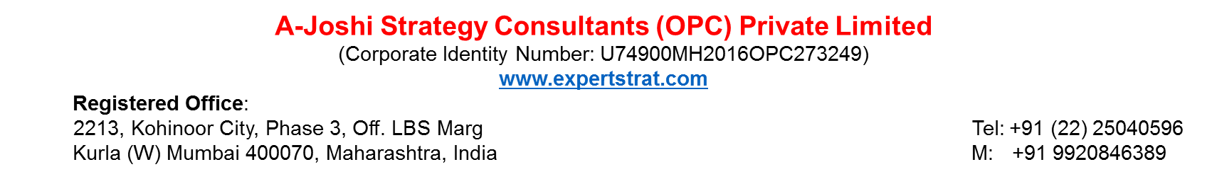
Corporate Purpose
Knowledge has now become the fourth factor, after Land, Labour & Capital, due to its critical role in Growth, Innovation & Productivity. As an organization based on leading edge Knowledge, our philosophy is that it is a force-multiplier for modern businesses, and grows exponentially when disseminated.
Our Corporate Purpose is to enable Success of Knowledge based businesses, through transfer of high quality Expertise based Knowledge to our Clients. We are Advisors & Consultants with critical capabilities & networks to deliver Practical Solutions for success in business, for large corporations & SMEs.
As part of our Social Responsibilities we participate in creation & dissemination of Knowledge through publications, studies, & mentoring of Entrepreneurs & Students. Highest Standards of Integrity at all times is our Core Value, and we demand this from ourselves & expect this from all those who interact with us. We enable Responsible & Sustainable Business Growth, which also makes a positive contribution to Society. We create Value for our Clients, and expect to create fair value for society.

